Slide 1



SEVA FIRST INNOVATION CHALLENGE 2026
INDRA — Autonomous Scout & Supervised-Delivery Drone for Disaster
Management

Slide 2
TEAM DETAILS
Project | INDRA — Indigenous Network for Drone Research & Autonomy
Track | Disaster Management — Scout & Supervised-Delivery Drone
Organising body | DTU ALTAIR & NEURAL AI
Primary focus | Autonomous navigation, casualty detection, geotagging and human-supervised payload delivery
Team Leader | DUSHANT
Team members | HIMANSHU YADAV ,MUSKAN SHUKLA , RONAK

Slide 3

Detailed problem statement
The problem
Floods, earthquakes, collapses and landslides make zones unsafe; every minute of delay costs lives.
Today’s search relies on helicopters, ground teams or pilot-flown drones: slow, and limited by terrain and manpower.
Full autonomy near survivors is unsafe, so a human must stay accountable for every drop.
Rules of the challenge
Drone searches, detects and geotags automatic; the operator never flies it.
No drop without any confirmation, target specific confirmation.
Standard 10-inch kit is assembled on the
spot; we bring only add-ons.
Safety pilot with RC override, geofence and kill-switch.
Our own innovations
One-time confirmation token: tied to one target’s coordinates, expires in 60 s.
Two-key release: software token plus a hardware relay, so one bug cannot drop.
Multi-frame voting: flag only when several
frames agree.
Visual recheck: re-detect the marker and centre on it before release.
Confidence-ranked queue and auto mission report.
Safe-zone lock: no drop outside the allowed area or on signal loss.
Search
Detect
Geotag
Operator confirms
Recheck + drop
Return + report
No confirmation, no drop. Everything runs on a ₹5–6k add-on budget over the campus drone kit.

Slide 4

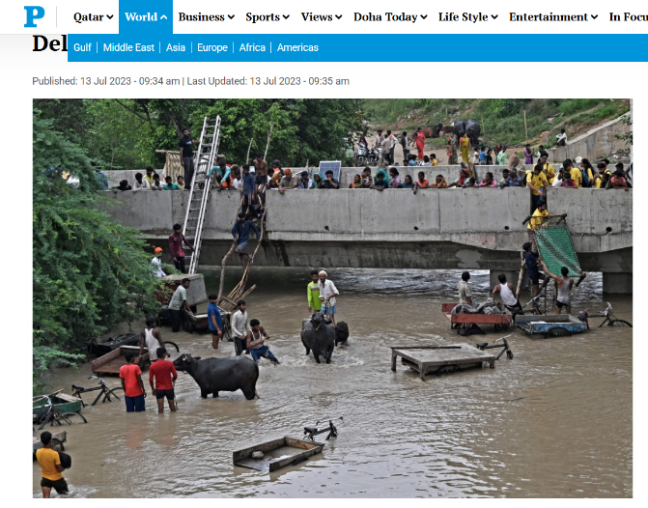
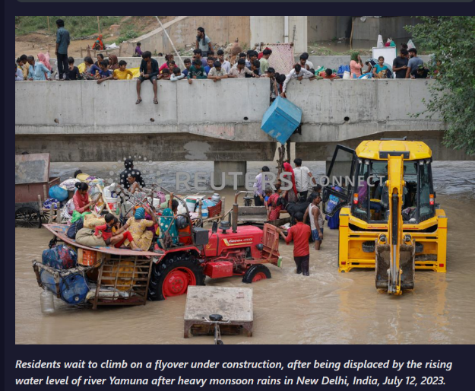
Evidence/data/survey/interviews
Evidence from the brief and public precedent
The brief says disaster zones are often unsafe or impossible to enter fast, and speed decides how many people survive.
Current options (manned choppers, ground search, pilot-flown camera drones) are slow and limited by terrain and manpower.
NIDAR (MeitY, Drone Federation India’s SwaYaan Initiative) already runs “Scout and Deliver” student challenges.
Judges score detection, false positives, geotag and drop error, mission time and any unconfirmed drop; our design targets each.
“Rising water levels of the Yamuna in Delhi, July 2023
Primary research we will run (planned)
Interview NDRF / SDRF or fire-service responders on how searches run and what makes a drone detection trustworthy.
Talk to drone pilots about false positives, failsafes and confirmation screens.
Observe a mock drill or campus demo and time the confirm / reject step.
Record findings, photos and quotes on this slide.
“Displaced residents wait to climb a flyover under construction, 12 Jul 2023. Photo: Reuters.”
Interview
Observe
Find gaps
Update design
Re-test
Planned evidence loop; add real findings as they are collected.

Slide 5
Existing solutions and limitations
Approach | How it works | Limitation | INDRA’s answer
Manned helicopters / ground teams | Crews search and carry aid | Slow to mobilise; terrain, weather, manpower limits; risk to crews | Drone scouts first and pins exact coordinates
Pilot-flown camera drones | Operator flies and watches live video | Needs a skilled pilot; coverage depends on attention | Autonomous search; operator only decides
Thermal enterprise drones | Heat cameras spot people | Costly; humans still mark casualties; no delivery | RGB + ArUco / heat-blob detection on a ₹5–6k add-on
Fully autonomous delivery drones | Fly to a point and drop | No human check; unsafe near survivors | Token-gated confirmation before any drop
INDRA (ours) | Auto search, geotag, supervised drop | Needs reliable detection and a stable link | Voting, recheck, failsafe return-to-home

Slide 6
PROPOSED TECHNICAL SOLUTION
A Autonomous navigation
B Detect & geotag
C Human-gated drop
D Return & report
DTU kit flight controller on ArduPilot / PX4 (confirm from BOM)
Lawn-mower waypoints inside a GPS geofence
2 ultrasonic sensors stop and sidestep obstacles
Failsafe: return-to-home on link loss or low battery; hover then land on GPS loss
Pi Zero 2 W + camera run OpenCV ArUco and a light TFLite detector
Several frames must agree before a flag
Pixel to ground GPS from pose, height and camera angle
Coordinates, confidence and snapshot go to the GCS
Queue ranked by confidence; operator taps Confirm or False positive
Confirm creates a one-time token for that target only
Drone approaches, rechecks the marker, centres, releases
Relay + servo stay closed without the token
Return and land after all drops or on end command
Every detection, request, confirmation and drop is time-stamped
Auto report: map, timestamps, drop status, payload log
Kill-switch and safety pilot always live
Hard safety gate: no payload release unless a live, target-specific human confirmation is recorded in the mission log.

Slide 7
CONCEPTUAL ARCHITECTURE
ON THE DRONE
GROUND CONTROL STATION
Live map + geotags
Sensors
GPS (to FC), RGB camera, 2×
ultrasonic
Companion computer
Pi Zero 2 W: detect, geotag, mission
logic
Wi-Fi: coords + snapshot
Detection queue (by confidence)
Confirm token
MAVLink
Confirm / Reject
Motors + ESCs
DTU kit
Flight controller
DTU kit, ArduPilot / PX4
Release interlock
relay + servo, closed by default
Mission log + report
How it fits together
The DTU kit supplies airframe, motors, ESCs, flight controller and battery; we add only the Pi, camera, GPS, sensors and release.
The Pi thinks and talks MAVLink to the flight controller; the flight controller flies.
Operator confirm sends a one-time token back; the Pi arms the relay only for that target.

Slide 8
WORKING PRINCIPLE
Takeoff inside geofence
Obstacle ahead?
No
Casualty detected?
Yes
START
Fly lawn-mower search
Geotag + send to GCS
No confirmation, no drop. Every step is time-stamped in the mission log.
Yes
No
Avoid, replan, resume
Keep searching
More targets / area?
Approach + visual recheck, centre
Issue one-time token (ID, coords, expiry)
Yes
Operator confirms?
Arm relay, release payload
Yes
No
No
Return home, land, auto report
Resume search pattern
False positive: log, resume search

Slide 9
PRELIMINARY CALCULATIONS/SIMULATION
Core formulas
Footprint W = 2·h·tan(HFOV/2)
GSD = W ÷ image width (px)
Line spacing = W × (1 − overlap)
Geotag error ≈ GNSS error + h·tan(attitude error)
Fall time t = √(2h/g); wind drift ≈ wind speed × t
Example: h 10 m, 62° HFOV, 1920 px | Result
Footprint / GSD | 12.0 m / 0.63 cm per px
Line spacing (30% overlap) | 8.4 m
50 × 50 m arena | 6 passes, ≈ 342 m, ≈ 86 s at 4 m/s
1° tilt at 10 m | ≈ 0.17 m geotag error
Drop from 3 m | t ≈ 0.78 s
2 m/s crosswind | ≈ 1.6 m drift
Model drone in ArduPilot SITL
Fly mission in Gazebo
Log errors and metrics
Tune parameters
Repeat on the drone
Standard GNSS is roughly 2–3 m accurate, so for the 1.5 m drop target the final approach centres on the marker visually instead of trusting GPS alone.

Slide 10
ESTIMATED COST
Provided by DTU on campus (not costed)
Budget-friendly 10-inch class kit: frame, motors, ESCs, flight controller, battery, basic hardware
Needed on campus for build, calibration and testing
Exact BOM to be published by organisers
Our fund request
≈ ₹5,300 – 6,000 for add-ons only, within the
₹5–6k ask
Team-supplied add-on | Indicative cost (₹)
Raspberry Pi Zero 2 W (companion computer) | 1,800 – 2,000
Pi camera module (5 MP, RGB) | 700 – 800
microSD card, 32 GB | 350 – 400
GPS module (NEO-6M / M8N class) | 600 – 700
2× ultrasonic sensors (obstacle) | 250 – 300
Servo + 3D-printed release bracket | 300 – 350
5 V buck converter, wiring, connectors | 400 – 450
Propeller guards (printed / low-cost) | 400 – 500
Misc. and spares (tape, ties, spare servo) | 500
Total (add-ons only) | ≈ 5,300 – 6,000
Telemetry uses the Pi’s built-in Wi-Fi (₹0). Thermal camera, RTK and LiDAR are left out to stay in budget. Prices are indicative; confirm with quotes.

Slide 11
EXPECTEd BENEFICIARIES
Survivors
Found sooner, with an exact coordinate
First-aid, food or water dropped while teams are still en route
Rescue teams (NDRF / SDRF / fire)
Unsafe zones scouted without risking crews
Geotagged casualty map to plan the approach
Disaster authorities
Time-stamped, auditable mission logs
Autonomy with a named human accountable
Students and innovators
Low-cost, open-source autonomy + GCS stack
Reusable for future drone-SAR research
Fast scouting
Exact geotag
Human verifies
Aid dropped
Rescuers follow map
Value chain: faster search turns into faster aid.

Slide 12
INITIAL DEVELOPMENT PLAN
Phase 1 · Wk 0–3
Phase 2 · Wk 4–8
Phase 3 · Wk 9 on
Phase 4 · Before final
Study the brief; fix mission rules and failsafe choice
Block diagram, safety case,
₹5–6k cost plan
Submit design report (Week 3)
Request the campus drone kit after shortlist
Detector on test footage and ArUco targets
Geotag maths; relay + servo bench test
GCS confirm / reject screen; raw video + note (Week 8)
Bring up Pi, camera, GPS, servo on the kit
Fly search, detect, confirm, drop end to end
Tune accuracy and failsafes
Timed assembly drills with the DTU kit
Pre-flight checklist, kill-switch test, log audit
Viva Q&A rehearsal
Milestones: Round 1 report (Wk 3) → shortlist (Wk 4) → Round 2 video (Wk 8) → finalists (Wk 9) → 2-day on-campus final.

Slide 13
EVIDENCE OF USER/PROBLEM INTERACTION
Stakeholder | What we ask / observe | Method | Design change it informs
Responders (NDRF / SDRF / fire) | How a search is run; what makes a detection trustworthy | Interview | Confidence score and snapshot shown to operator
Drone pilots / operators | False positives, failsafes, confirmation screens | Interview + demo | Voting rule, failsafe choice, GCS layout
Safety pilots / faculty | Kill-switch and failsafe expectations | Safety review | Checklist and interlock design
Peer operators | Time and errors when confirming or rejecting | GCS usability trial | Queue ranking, token expiry time
Plan
Interview
Observe
Insight
Update design
Re-test
Planned; findings, photos and quotes will be added as interactions are completed.

Slide 14
75-DAY WORK PLAN
Activity
0
Day 15
Day 30
Day 45
Day 60
Day 75
Requirements, design freeze
1–10
SITL: search + failsafes
11–25
Detector + geotag maths
11–30
Hardware bring-up on campus kit
26–40
Integration + GCS confirm flow
41–55
Field tests + accuracy tuning
56–68
Assembly drill, report, viva
69–75
Milestones: Day 25 simulation demo · Day 40 bench-tested · Day 55 first end-to-end flight · Day 68 accuracy targets met · Day 75 final-ready.

Slide 15
TEAM COMPOSITION AND ROLES
Team Leader & integration
DUSHANT
Autonomy & flight software
Vision & geotagging
GCS, UI & logging
Payload & electronics
Safety pilot (separate)
Search pattern, geofence
Obstacle avoidance
Failsafes (RTH, hover)
Member: DUSHANT,HIMANSHU
Detector + ArUco
Multi-frame voting
Pixel to GPS maths
Member: MUSKAN,DUSHANT,
RONAK
Map + detection queue
Confirm / reject + token
Mission log + report Member:
HIMANSHU,MUSKAN
Release servo + relay
Wiring, power, mounts
Bench + drop tests
Member: MUSKAN,RONAK
RC override, kill-switch
Pre-flight checklist
Not the autonomy
operator
Member: DUSHANT

Slide 16
RESOURCE/FACILITY REQUIREMENTS
Kit on campus
Assemble + wire
Calibrate
Bench test
Field test
Drone kit (requested on campus)
Budget-friendly 10-inch class kit from DTU
Space and time to assemble, wire and calibrate it
Spare props and a charged battery set
Compute and software
Raspberry Pi Zero 2 W, camera, GPS
ArduPilot / PX4, SITL, Gazebo, OpenCV, TFLite
Laptop as GCS, GPU or Colab for training
Test space and props
Netted or open field cleared of the public
Mannequins, ArUco targets, heat sources
250 g – 1 kg mock relief packets
Safety and compliance
Fire extinguisher, first-aid kit, LiPo-safe charging
Propeller guards, kill-switch, RC transmitter
DGCA Drone Rules 2021; Digital Sky / UIN if needed

Slide 17
ENTRY AND TARGET TRL, IF ANY
TRL 9
Proven
TRL 8
Qualified
TRL 7
Field demo
TRL 6
Prototype
demo
TRL 5
Arena test
TRL 4
Bench test
TRL 3
Proof of concept
TRL 2
Concept
TRL 1
Principles
Entry: TRL 3 (proposed)
Concept, architecture and safety interlock defined
Detector and geotag maths still to be proven in simulation and on the bench
Target: TRL 5–6
Integrated prototype flies the arena autonomously
Detect, geotag, confirm and drop shown live
Logs and mission report generated automatically
How we climb
TRL 3 to 4: SITL and bench tests of detector, relay, GCS
TRL 4 to 5: low-hover tests on the campus kit
TRL 5 to 6: full arena run with safety pilot

Slide 18
TECHNICAL DRAWINGS/CALCULATIONS/SIMULATION
FRONT ▲
GPS
to flight controller
Flight controller
DTU kit
GCS laptop
Wi-Fi
UART
Pi Zero 2 W
Kit FC Release
Pi camera
CSI cable
Raspberry Pi Zero 2 W detect, geotag, mission logic, token check
Safety relay
signal gate
2× ultrasonic
GPIO + divider
Battery → 5 V buck
from kit battery
Servo release
Top view, concept, not to scale. Camera faces down; ultrasonic sensors face front and side.

Slide 19
LITERATURE/PATENT SURVEY
Source | What it gives | How we use it
NIDAR / SwaYaan (MeitY, DFI) | National Scout-and-Deliver challenge | Benchmark for mission design
ArduPilot / PX4, MAVLink | Open autopilot and message protocol | Waypoints, geofence, failsafe, Pi–FC link
YOLO (Redmon et al., CVPR 2016) | Real-time object detection | Light detector idea for the Pi (TFLite)
ArUco markers (Garrido-Jurado et al., 2014) | Robust fiducial detection (OpenCV) | Casualty markers and final centring
DGCA Drone Rules, 2021 | Weight class, registration rules | Stay compliant at the venue
Patent survey (planned) | Prior art on UAV casualty geotagging | Confirm novelty of token + two-key release
Pick keywords
Search InPASS + Google
Patents
Compare claims
Note differences
Decide IPR
Patent search still to be done; findings will be recorded here.

Slide 20
L A B O R A TO R Y / F A B R I C A T I O N A C C E S S
CAD
3D print
Assemble
Bench test
Field test
Fabrication
3D printing: release bracket, camera mount, prop guards
Soldering and electronics bench for wiring
LiPo-safe charging and storage
Testing
Netted or open test field cleared of the public
GCS laptop and Wi-Fi link check
Mannequins, ArUco and heat-source targets
Support needed
Campus lab or makerspace access
Early access to the DTU kit for prototyping
Faculty and safety-pilot supervision
Source: DTU campus lab / makerspace, to be confirmed with the host institution.

Slide 21
NOVELTY AND IPR POTENTIAL
Multi-frame vote flags target
Operator taps Confirm
One-time token (ID, coords, 60 s)
Pi arms safety relay
Visual recheck + centre
Release + log
Novelty (to be checked by patent survey)
Token-gated release: a drop is possible only for the target the operator confirmed
Two-key interlock: software token plus a hardware relay
Visual recheck before release beats GPS error
Confidence-ranked queue with snapshot for faster decisions
Complete autonomy + GCS stack on a ₹5–6k add-on budget
IPR potential
Per the brief, IP stays with participants; organisers keep a non-exclusive right to publish results, imagery and performance data
Software and GCS UI: copyright
Release bracket and interlock layout: design registration
Patent decision only after the survey

Slide 22
REFERENCES
SEWA FIRST Innovation Challenge 2026, INDRA Problem Statement, Version 1.
NIDAR, MeitY and Drone Federation India, SwaYaan Initiative.
Drone Rules, 2021 (India) and later amendments, DGCA / Ministry of Civil Aviation. https://www.civilaviation.gov.in/ministry-documents/rules/drones-rules-2021-dated-25-august-2021
ArduPilot documentation (incl. SITL), ardupilot.org. https://ardupilot.org/dev/docs/sitl-simulator-software-in-the-loop.html
PX4 Autopilot documentation, px4.io. https://docs.px4.io/main/en/
MAVLink protocol, mavlink.io. https://mavlink.io/en/
J. Redmon et al., “You Only Look Once: Unified, Real-Time Object Detection,” CVPR 2016. https://ieeexplore.ieee.org/document/7780460
S. Garrido-Jurado et al., “Automatic generation and detection of highly reliable fiducial markers under occlusion,” Pattern Recognition 47(6), 2014. https://www.semanticscholar.org/paper/Automatic-generation-and-detection-of-highly-under-Garrido-Jurado-Mu%C3%B1oz-Salinas/2d90537b709ae92e07856b93aab70614ac5af561
OpenCV documentation, ArUco marker detection, opencv.org.
Gazebo simulator, gazebosim.org. https://gazebosim.org/home
Chat gpt (for research)
https://www.slideshare.net/slideshow/drone-componentspptx/259226017#2( for knowing about drones)

